Slide 1
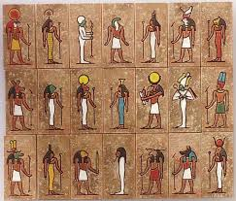
Ancient Egypt
7500 BC to AD 30
For 3000 years Egypt was ruled by pharaohs, believed to be living gods.
Hieroglyphs were used to keep records
2555BCE pyramids built at Giza
2520 BCE Great Sphinx built
1332 BCE 10 year reign of Tutankhamun begins
51 BCE Cleopatra’s reign begins and Egyptian civilisation ends
Settlements were by the Nile so flooding could fertilise crops
They worshiped more than 2000 Gods and Goddesses
Pharaohs underwent the mummification process when they died so they could live again with their bodies in the after life

Slide 2
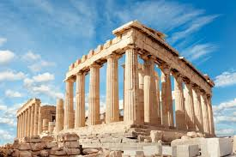
Ancient Greece
776 BC to 146 BC
The first Ancient Greek civilisations were formed nearly 4,000 years ago (approximately 1600 BC) by the Mycenaeans of Crete
The Ancient Greek Empire spread from Greece through Europe and, in 800 BC, the Greeks started to split their land into city-states, each with its own laws, customs and rulers
The Ancient Greeks had lots of stories to help them learn about their world. The gods featured heavily in these tales, and so did mythological monsters
Statues of Greek gods and goddesses were placed inside temples, the most famous of which is the Parthenon. This temple in Athens was built for the goddess Athena, the protector of the city
Most Ancient Greeks wore a chiton, which was a long T-shirt made from one large piece of cotton
A famous legend tells how, in 1180 BC, the cunning Greeks conquered the city of Troy – by hiding inside a giant wooden horse
They loved watching plays, and most cities had a theatre. Only men and boys were allowed to be actors, and they wore masks, which showed the audience whether their character was happy or sad
The Ancient Greeks held many festivals in honour of their gods. To celebrate the god Zeus, for example, the first Greek Olympics were held in the city of Olympia in 776 BC
Events at the Olympics included wrestling, boxing, long jump, javelin, discus and chariot racing

Slide 3
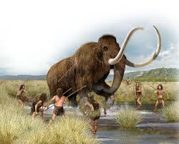
Stone Age
15 000 BC to 2500 BC
Began around 4 million years ago when the first humans left Africa
First people arrived in Britain 700 000 years ago
There are very early cave paintings in Spain and France
Homo Habilis, early humans from 2000 years ago, started using stone tools
People started using animal hides to create tents
On the Orkney Islands there are 5500 year old stone houses in a small community
Split into 3 periods: Palaeolithic Age, Mesolithic Age and Neolithic Age
During the Mesolithic Age wolves were domesticated into dogs and used to help hunt for food
12000 BC no more woolly mammoths in Britain
People start to ride horses, create simple pottery and farm
Stone Henge is built
People start using wheels
Moved from hunter gatherers to farmers

Slide 4
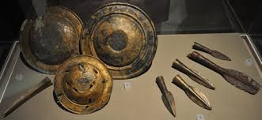
Bronze Age
3000 BC to 800 BC
Started at different times in different countries
Bronze axes developed leading to advances in wood working
Bell beaker culture arrives with people making detailed pottery for use and as a sign of wealth
Large copper mines are dug (Bronze is an alloy of copper and tin)
People started to make clothing from wool
Tribal culture and Celtic kingdoms start to emerge towards the end of the period
Metal work increases
Small axes and leaf shaped blades are used
Wetter weather forced people to move from the hills to the valleys to find shelter and grow food
Farming spread and a lot of woodland was cut down
People started to use houses for different functions such as sleeping and cooking

Slide 5
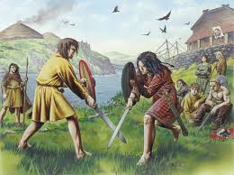
Iron Age
800 BC to AD 43
Lasted for about 800 years in Britain
Iron replaced Bronze as the chosen metal for weapons and tools
Europeans in this period are known as Celts
Iron was smelted using a coal fired furnace and shaped by a smith
People worshiped multiple Gods and Goddesses inhabiting the world around them
Druids and priests were religious leaders who carried out rituals and gave advice
Carpentry tools were developed
100 BC coins are used in Britain for the first time
Iron was easier to work with than bronze and could be shaped into finer objects for weapons and farming
People started constructing hillforts, settlements on hill tops where hundreds of people lived
People lived in round houses with thatched rooves and wattle and daub walls
Britain was mostly settled farming communities
Animals were kept for meat, milk and wool so more woodland was cleared.

Slide 6
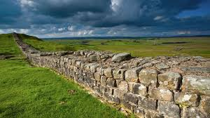
Romans in Britain
AD 43 to AD 410
55 BC Julius Caesar raids the coast for the first time and comes back a year later with more men
The British tribes agreed to pay tributes to Rome
In 43 AD Emperor Claudius’ army invaded and took control of the land
Many Celtic tribes made deals to keep their land
Roman governors were in charge and several tribes rebelled
Boudicca led the Iceni tribe to many victories against the Romas until she died in AD 61
The Romans built many forts in an effort to conquer Caledonia
The Pict tribes kept causing trouble so Emperor Hadrian built a wall in AD 122
The Fosse way was one of the first major Roman Roads in Britain. The Romans built over 2000 miles of roads here
The Romans built steam heated bath houses and transported water to them using aqueducts. The Baths also had gyms.
The Romans worshipped many Gods, some the same as the Greeks but with different names.
In 313 Emperor Constantine converted Rome to Christianity
The Romans slowly left Britain at different times from different places as the Angles, Saxons and Franks advanced

Slide 7
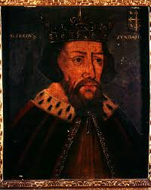
Vikings and Anglo Saxons
AD 793-1066 449 - 1066
The Vikings started raiding in long ships from Scandinavia from 787 AD
They were looking for things to steal and trade
In AD 866 they captured York
Alfred the Great in Wessex kept them out of the south for a while but they decided to settle here and eventually Wessex was the only kingdom left not controlled by Vikings
Most Vikings lived on farms
Vikings believed in Gods like Thor and Odin but eventually converted to Christianity
Vikings lived in houses made of wood, stone and wattle and daub
Anglo-Saxons once worshipped lots of different gods that they believed controlled all areas of life, but around the 7th century many converted to Christianity after the arrival of the missionary St. Augustine from Rome
Beowulf is an Anglo-Saxon heroic poem (3182 lines long) which tells us a lot about life in Anglo-Saxon times (though it is not set in England but in Scandinavia).
The letters of the Viking alphabet were called runes
Vikings told stories known as sagas and made up riddles
Vikings made objects from leather, wore intricate jewellery and ate from wooden bowls
Alfred the Great made a deal with King Guthrum and gave the Vikings control of the East. Various Viking and Anglo-Saxons kings then ruled.
Different kingdoms had different laws but there were no prisons and punishments were brutal
A jury would decide if a defendant was guilty or innocent. If no decisions was reached there would be a trial by ordeal to let God decide
Some of our modern English words, such as the days of the week, come from the Anglo-Saxon language (sometimes called Old English).
In 1066 Harold II fought William Duke of Normandy at the Battle of Hastings and lost

Slide 8
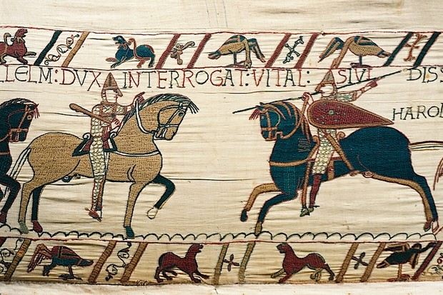
Normans
1066 to 1154
The Normans came from northern France, in a region called Normandy. The first Norman King was William I who defeated King Harold at the Battle of Hastings in 1066
The Bayeux Tapestry tells a story in pictures about the Norman invasion of Britain and the Battle of Hastings. It is held in France but was probably made by nuns near Canterbury
William wanted to know who lived here and who owned what so he sent out government officials to survey the land in 1086. The result was the Domesday Book.
The Normans built wooden houses covered in a mixture of mud, dung and straw, which kept them warm in the winter.
The Normans built some of the first stone castles in England, including Windsor Castle and the Tower of London. They wanted to make sure that they could defend England from any more invaders
After the Norman invasion there was a Feudal system with William and his French knights and barons at the top and lowly serfs at the bottom.
The law and the language were affected and we still use many Norman French words today.

Slide 9
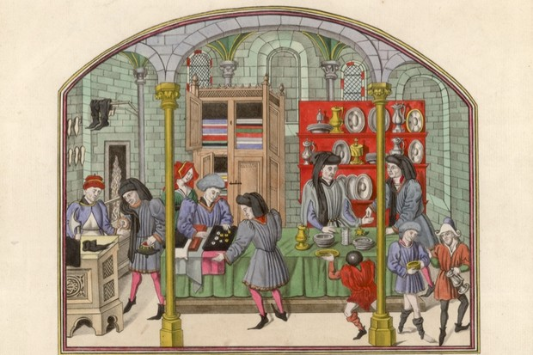
Middle Ages
1154 to 1485
1399 Henry Bolingbroke took over the throne and became the first king from the house of Lancaster (Henry IV), ending the rule of Norman kings
1415: Henry V defeats the French at Agincourt
Pope Urban II’s official call for “holy war” in 1095 started the first crusade to the Holy Land
Archbishop of Canterbury, Thomas Becket was murdered in Canterbury Cathedral in 1170, after knights misinterpreted orders from Henry II. The site then became hugely important for pilgrims.
The Middle Ages famously features great examples of extreme religiosity: mystics, saints, the flagellants, mass pilgrimage etc.But it would be wrong to assume that people were always very focused on God and religion.
The summer of 1348 saw the first outbreak of the bubonic plague in England. The disease is estimated to have killed between a third and a half of the population.
In the cities, people had all kinds of jobs: merchants, salesmen, carpenters, butchers, weavers, food sellers, architects, painters, jugglers
Many peasants were free men – and women – and owned their own land, while others who were to some degree ‘unfree’ in fact bought and sold land and goods, much like other free men.
In the 12th century Medieval intellectuals also had a ‘renaissance’ of classical learning and rhetoric.
Sealed by King John at Runnymede on 15 June 1215, Magna Carta (meaning ‘great charter’) has become one of the founding documents of the English legal system. John was reluctantly forced to sign Magna Carta as part of peace negotiations with rebel barons
In 1314 at the battle of Bannockburn Scottish leader Robert the Bruce took on the English king Edward II in a pivotal conflict in Scotland’s fight for independence. Robert the Bruce’s victory proved decisive for Scotland, In 1324 Robert finally gained papal recognition as king of Scotland.
The first large-scale uprising in English history, the Peasants’ Revolt of 1381 threatened to overturn the existing social structure and undermine the country’s ruling elite.
1485: Richard III is defeated at the battle of Bosworth by Henry Tudor (Henry VII)

Slide 10
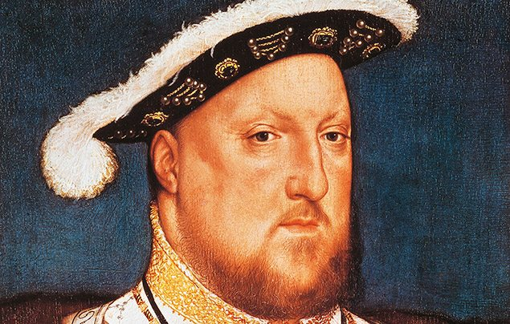
The Tudors
1485 to 1603
The first Tudor monarch was King Henry VII who claimed the throne when his forces defeated Richard III at the Battle of Bosworth Field in 1485
The Tudor rose was created when Henry VII brought an end to the Wars of the Roses (an ongoing battle between two royal groups – the House of Lancaster and the House of York). He joined the White Rose of York with the Red Rose of Lancaster, creating the Union Rose (or Tudor Rose)
During 118 years of Tudor rule, England became richer than ever before. As the country became wealthier, towns grew, beautiful houses were built and schools and colleges were set up. Arts and crafts flourished. England was home to great painters, writers and musicians.
In 1534, Henry broke away from the Catholic Church and proclaimed himself head of the Church of England.
Edward VI was the only son of Henry VIII and became king at the age of nine. His mother was Jane Seymour, Henry Vlll's third wife. He died at the age of 16 in 1553.
While Edward was still alive his ministers persuaded him to make a will naming Lady Jane Grey his successor to the throne. She was a Protestant unlike Edward's half sister Mary . Lady Jane Grey ruled for only 9 days before Mary had her arrested and later executed.
Mary I was the next monarch and she returned the country to Catholicism and persecuted Protestants. She died childless.
Elizabeth I's rule is remembered as the Golden Age of English history. Under her rule, England advanced in such areas as trade, exploration, literature, and the arts.
During Elizabeth's reign the age of exploration began with explorers such as Francis Drake claiming new lands for England and introducing new materials and foods.
The Tudor period ended with the death of Queen Elizabeth I on 24th March 1603 after 45 years on the throne.

Slide 11
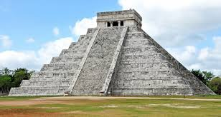
Mayans
1100 BC to AD 1502
The Maya civilisation came into being around 2000 BC and cities such as El Mirador became large and powerful from 300 BC onwards.
The ancient Maya were a clever, deeply religious people who valued intelligence and learning.
They developed a writing and number system; studied and charted the stars and planets; invented three complex calendars to keep track of time; built impressive temples, palaces, monuments and cities; skilfully farmed the land and established a complex political system.
Cities like Chichen Itza were still thriving in AD 1000 and the Maya civilisation was still in existence in AD 1500.
It was due to the arrival of the Spanish in the 16th century that their ancient cities fell to ruin.
Mesoamerica refers to an area where a number of societies had been formed before the Spanish arrived in the 16th century. It covers Mexico and the northern parts of Central America. ‘Mesoamerica’ can also refer to the culture of the people who lived there. The Maya lived in the south east of this area.

Slide 12
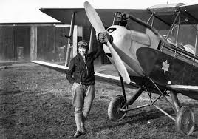
Famous Explorers
Christopher Columbus was an Italian explorer and navigator. In 1492, he sailed across the Atlantic Ocean from Spain in the Santa Maria, with the Pinta and the Niña ships alongside, hoping to find a new route to India but instead found America.
Amelia Mary Earhart was an American aviation pioneer and author. Earhart was the first female aviator to fly solo across the Atlantic Ocean. She set many other records but disappeared in 1937 over the Pacific Ocean.
Amy Johnson CBE, was a pioneering English pilot who was the first woman to fly solo from London to Australia in her plane ‘Jason’. On 5th Jan 1941 reportedly out of fuel, she bailed out as her aircraft crashed into the Thames Estuary near Herne Bay.
Neil Alden Armstrong was an American astronaut and aeronautical engineer and the first person to walk on the Moon in 1969. He was also a naval aviator, test pilot, and university professor.

Slide 13
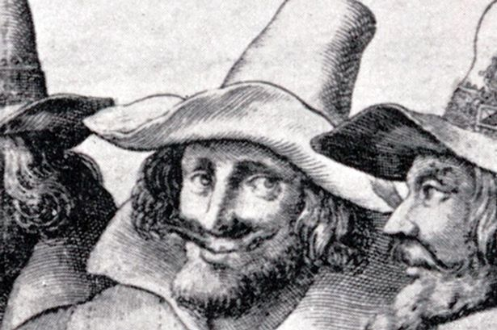
Gunpowder Plot
1605
England had become increasingly Protestant during the reign of Elizabeth I
In 1606 King James, a Protestant, was on the throne
Guy Fawkes was Catholic and had served in the Spanish army
Robert Catesby came up with the plan to kill the king and put a Catholic monarch back on the throne. There were 13 conspirators in total.
On October 26, Lord Monteagle, a member of the House of Lords received an anonymous letter warning him not to attend the opening of the Parliament on November 5.
The conspirators had secured lease of a cellar beneath the House of Lords with Fawkes in charge of the gunpowder they stockpiled there. Hours before the attack was supposed to have taken place the authorities while conducting a search found Fawkes guarding 36 barrels of gunpowder
Most of the conspirators fled from London. Guy Fawkes initially maintained that he acted alone but after two days of torture he gave the identities of his co-conspirators. The plotters made their final stand at Holbeche House in Staffordshire, where several, including Catesby, died in a shoot-out with the king’s men. The eight that survived, including Fawkes, were executed by being hanged, drawn and quartered in January 1606

Slide 14
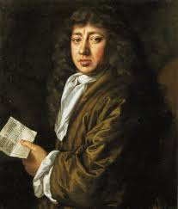
Great Fire of London
1666
Started in Thomas Farriner’s Bakery in Pudding Lane on 2nd September 1666
The fire spread quickly because the wooden houses were close together and there was a strong wind
Samuel Pepys kept a diary of the main events
The duke of York ordered some houses be blown up to prevent the fire spreading further
After the fire the streets were made wider and houses were re-built in brick
The fire killed plague carrying rats
The Monument in London was built to remember the fire
The fire burned from Sunday to Thursday
St Paul’s Cathedral burnt down in the fire

Slide 15
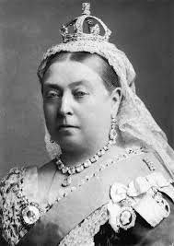
Victorians
1837 to 1901
Britain expanded its territory throughout the world and became the largest, richest and most powerful empire in world history
New inventions like the telephone, motorcar, typewriter, bicycle and moving film totally changed the way that people lived, worked and travelled.
Expansion of the railways meant that people could travel faster and further than ever before.
The boom in industry saw lots of people moving to cities to find work. For the first time in world history, more people lived in cities than in the countryside, making city centres very cramped
As technology advanced, new machines left lots of people without jobs. Many resorted to workhouses, which provided basic poor relief like food, medical care and shelter in exchange for labour
The Bank Holidays Act of 1871 introduced extra days off throughout the year. Banks and offices would close and people could take time off work. The first travel agent, a businessman named Thomas Cook, ran trips to the seaside
Many charities for the poor, like the Salvation Army and Barnardo’s, were established during the Victorian era.
Many children worked in factories, coal mines and as chimney sweeps
Queen Victoria believed that education should be for all, and by the end of her reign, going to school became compulsory for all children, rich or poor
Improvements in education meant that more people could enjoy reading
Some of Britain’s best-known poets, thinkers and authors flourished in the Victorian era, like poet Elizabeth Browning, playwright Oscar Wilde and authors Emily Brontë and Charles Dickens
Healthcare saw huge improvements under the Victorians. Medical pioneers like Florence Nightingale worked with the government to improve hospital cleanliness

Slide 16
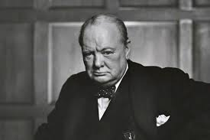
World War II
1939 to 1945
12th March 1938 Germany invades Austria
23rd August 1939 Germany and Russia sign a pact and agree to divide Poland
3rd September 1939 Neville Chamberlain declares Britain is at war. Canada, France, South Africa and Australia join.
1940 Winston Churchill becomes Prime Minister
May 1940 Germany invades France and Holland surrenders to Germany
The Home guard is formed and troops are evacuated from Dunkirk
1940 July and September The Battle of Britain and the Blitz
7th December 1941 Japan attacks Pearl Harbour in Hawaii and America declares war a day later
20th April 1943 Jews massacred by the Germans in Warsaw Ghetto
16th May 1943 the Dam Buster raid
6th June 1944 British and US troops land in Normandy
16th December 1944 Battle of the Bulge
12th January Soviets displaced the Germans from Warsaw, Krakow and Budapest
30th April 1945 Hitler died
7th May Germany surrenders
8th May 1945 Britain celebrates VE day
6th August 1945 atomic bomb dropped on Japan
2nd September 1945 Japan surrenders

